Slide 1
The Terminal Index-driving profits in a finishing system ? Christy Watson Teagasc

Slide 2
Beef Breeding Programme ?
100,000 Farmers involved in beef production
Beef production 38.8% GAO
Beef exports worth €2.38 billion
Live exports €100 million (145,000 cattle)
World class Beef breeding programme
Beef breeding-central to the environmental programme BDGP-2015 use genetically superior animals.
Notes:
BDGP-To lower the intensity of Greenhouse Gas Emissions by improving quality and efficiency on national beef herd.
Improve the genetic merit of the national beef herd through collection of data and genotypes of selected animals which will allow for genomic selection in the beef herd
I believe we have a world class beef breeding programme in Ireland, a critical critical assets for the beef industry.
The Beef Sector, with its almost uniquely widespread geographical coverage, is among the most important Irish indigenous industries. There are over one hundred thousand farms contributing to cattle output in Ireland.
The Irish Beef sector is mainly broken into Suckler producers and cattle finishers, with nearly 1.5 million head of cattle sent for slaughter in Irish meat processing plants in 2013 alone.
At €2.38 billion, the production of bovine animals accounted for 38.8% of the gross output of the agriculture sector in 2016, making it the most important primary agriculture product in Ireland at farm level.
Ireland has self sufficiency in beef of 650%

Slide 3
Farmers-Suckler,Store,Finishers
65% Beef Sired cattle move holding before 1 yr. old.
Finisher not Breeder
Complicates Beef Breeding Model/Message
Notes:
In 2016 approximately 1.5 million calves were born to a beef sire of these 968,636 (65%) moved from holding of birth before they were 1 year old . ( 568,624 mart movements, 400,012 farm to farm movements).
It is critical to involve the finishing sector in the conversation on beef breeding, they are such critical players in the industry they need to be included in our target audience.
Need buy in from finishers , they need to be informed of the existence of the indices and tools available so that they can make fully informed decisions when purchasing livestock and their subsequent management.
Farm to farm movements almost same as mart movements.
Beef breeding more complex in that there are more players involved, breeder, store keeper, finisher.
Dairy breeding more straightforward the breeder generally the same farmer who farms the animal.

Slide 4
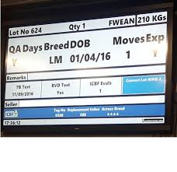
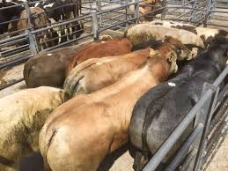
The Most Profitable Animal
Available Information
Visual Information
Notes:
Need to get it right as the purchase cost of the cattle accounts for up to 70% of direct cost of production.
When the specialist finisher goes to buy cattle they have many factors to take into account in a very short period of time, decisions need to be made in minutes as to what to buy and at what price. Some of the issues at play are.
Health Status of the animal.
Suitability for their finishing system.
Possible pre sale management of that animal, feed level etc.
Number of existing movements of that animal with regard to Quality Assurance payments.
Potential carcass quality, growth rate, and estimated time required to bring that animal to a level of finish to meet existing or expected market requirements.
What they are trying to do is buy the potentially most profitable animal for their particular system.
The cost of the animal for finishing can account for up to 70% of the direct costs of production.
So it is critical for viability of the system that the finisher purchases the most profitable animal, without knowing the complete history or potential of that animal.
But there is help available to the finisher in decision making-The Beef €uro- Star system was introduced in 2007 by The Irish Cattle Breeding Federation (ICBF), to essentially identify the most profitable cattle in the Irish beef herd.
In the area of climate change the impact of improved animal efficiency is recognised as making a positive contribution and hence the BDGP was introduced in 2015 and is scheduled to run for 6 years. The strength of this programme is that there is a requirement to use the identified more efficient animals.

Slide 5
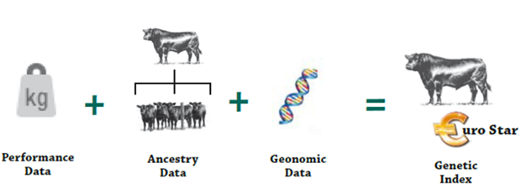
ICBF Terminal index
For selecting Bulls to breed animals for slaughter.
Identify more profitable animals for finishing system.
Expressed in money terms €uro
INDEX available on live animal from birth
Notes:
A legitimate question often asked is, how can ICBF evaluate animals when they have never seen them?.
Once the sire and dam of an animal is known ICBF, can evaluate any animal for both Maternal and Terminal traits.
In the herd of birth, the first data on an animal recorded is the date of birth, sire and dam.
When animals move through a mart the date of movement and weight is recorded. Some farmers weigh their cattle and upload those weights to ICBF.
When the animal is slaughtered the date of slaughter and details of carcass weight, grade, fat score is recorded.
All of the information from performance and ancestry information is combined with Genomic evaluation where available to produce a Genetic Index for an animal. The genetic index is expressed in €uro`s as the goal of this process is to estimate how profitable an animal is for breeding or finishing for beef.
There are two overall €uro-Star Indices.
€uro-Star Replacement Index.
For identifying potential female replacements.
For selecting bulls and cows to breed potential replacements.
€uro-Star Terminal Index.
For selecting bulls to breed animals for slaughter.
For identifying animals with the greater potential to make more profit for finishers.
The ICBF can allocate an animal a Terminal index essentially from the date of birth.
So we now can make informed decisions armed with this information –especially the hard to measure traits linked to profit.

Slide 6
Terminal Index-Make up
Trait | Goal | Relative wt.
Calving | Less | 26%
Feed Intake | Less | 16%
Carcass Weight Conformation Fat | More | 56%
Docility | More | 2%
An animal with a terminal index of €150 (5 stars), is expected to leave an additional €100 more profit than an animal with a terminal index of €50
Notes:
So we now have an additional tool available to the finisher when he/she is in the market to purchase store animals for their finishing enterprise. The Terminal Index brings to light the contribution the genetic potential of the animal makes to the relative profitability of the animal in question.
From a beef finishers perspective the Terminal Index is the relevant index, as it is specifically targeted to identify the most profitable animals that are intended for slaughter. The makeup of the Terminal index is shown in
Carcass weight for age made up 56% of index ( Carcass weight+ Conformation+Carcass fat).
The two big contributions to profitability are feed intake- less is better and carcass traits weight for age, conformation and fatness.

Slide 7
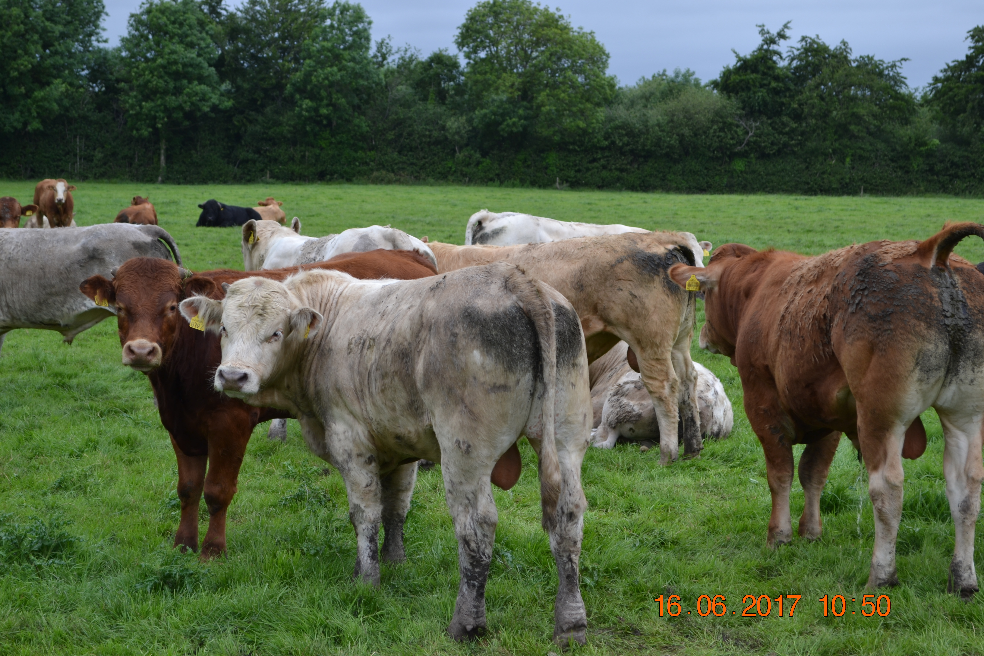
Beef Finisher
440 Bulls Slaughtered
Full Data on 240
Notes:
We can legitimately ask the question is the Terminal index currently identifying the most profitable animals for a finishing system operated at farm level. It is essential to test the system at farm level and to demonstrate locally the relevance of the index.
What I call the big data –national figures clearly demonstrate that the index is working and is identifying the superior animals for a finishing system.
We must also not underestimate the influence of disease,environment and management on animal performance , which some people estimate influences 66% of performance with genetics contributing the balance of 33%. So good genetics with poor management does not bode well, on the contrary good genetics combined with good management is a receipe to exploit the true potential of the animal.
To try and answer this question I examined the slaughter data for one of my clients who purchases all the cattle he finishes on the open market. The data presented here is based on the cattle slaughtered in the twelve months from April 2016 with complete purchase and slaughter data as well as having a Terminal €uro-star value allocated.
These are typical of the animals this man buys to finish in a bull beef system.
Of the 439 bulls slaughtered from April 16 to 2017 I had full data on 238 bulls ( 1,2=108, 3=93, 4,5=37).
Cattle bought through marts,off farm .

Slide 8
Phase 1-Breeder to Finisher
 | One and Two Star */** | Four and Five Star ****/***** | Difference 4,5 Star Vs. 1,2 Star
Purchase Weight Kgs | 444 | 441 | -3 kgs
Purchase Price € | €1,061 | €1,077 | +€16
Purchase Price €/kg | 2.39 | 2.44 | +5 cent/kg
Age at Purchase-days | 371 | 333 | -38 Days
Daily live weight gain to purchase kg/day | 1.08 | 1.20 | + 0.12 (11%)
Notes:
If we divide up the lifetime of the animals into two phases, with phase 1 birth to point of purchase by finisher, phase two the period on the finishing farm.
In this slide the data for phase one is presented, showing both animal performance and economic metrics from birth to sale to finisher.
The purchase weight for the two groups was almost identical, as was the price with a price difference of only €16 or 5cent/kg.
The price similarity between the two groups is to be expected as the buyer was buying essentially blindfold in relation to the genetic merit of the animals, he has not sourced cattle to date based on €urostar rating.
At this stage we can see that the group with the better Terminal index or 4,8 star were 38 days younger at sale and are beginning to move ahead of their lower star rated comrades. The difference in weight gain in favour of the 4,5 star animals is plus 11%.
This benefit accrued to the breeder- faster growth to sale, with a significant saving in feed costs as the animals were sold on average as yearlings, and are likely to be sold out of the sheds, the highest cost period for all cattle farmers.

Slide 9
Phase 2-Finishing Farm
 | One and Two Star */** | Four and Five Star ****/***** | Difference 4,5 Star Vs. 1,2 Star
Carcass weight kg | 383 | 426 | +43kg
Age at Slaughter days | 581 | 559 | -22 Days
Lifetime Carcass gain/day | 0.62 | 0.72 | +16%
Notes:
So the 4&5* animals had better growth rate performance up to point of sale to the finisher, so how did these animals perform relative to their 1&2* comrades on the finishing farm. Some of the key issues of interest to the farmer finisher are shown in this slide.
One might argue that the 4&5* cattle had heavier carcasses because they were fed for longer on the farm, and that to express their potential they have to be fed for a longer period hence reducing the advantage to the finisher of the superior genetics.
There are two points to be made in response to such a comment. Firstly the 4&5* cattle were kept 19 days longer on the finishing farm, but were still 22 days younger at slaughter than the 1&2* cattle.
Also if we correct for days on the finishing farm, and say what if the finisher decided to slaughter both groups after 210 days on the farm , and bearing in mind the superior daily carcass gain of the 4&5* group. This group would still have carcasses which were 28 kgs heavier than the 1&2* cattle.
In addition if both groups were slaughtered after 210 days on the finishing farm the 4&5* cattle would now be 41 days younger at slaughter and 28 kgs heavier than the 1&2* group. This result helps to dispel the myth that in order for these genetically superior animals to confer an advantage they need to be slaughtered at an older age, the point is that they actually reach target carcass weight faster than the genetically inferior animals.
The 1,2 star group were not responding as well to feeding and the farmer was quite correct to slaughter them sooner as they did not respond a swell to feeding as their 4,5 star comrades.
This reduced days to slaughter is very significant in a bull beef system with cattle on ad-lib concentrates clocking up daily feed costs in excess of €3.
The difference in carcass gain favours the 4,5 stars at 0.12 kg/day or 16% at todays prices that is worth approximately 50 cent per day .
The finisher gets paid on carcass weight, so fast growing cattle reach target slaughter weight sooner hence costs are reduced and efficiency is improved.

Slide 10
Animal performance-€€€€€€
 | One and Two Star */** | Four and Five Star ****/***** | Difference 4,5 Star Vs. 1,2 Star
Carcass Value | €1,506 | €1,650 | + €144
Gain in Value on Finishing farm | €2.37 | €2.95 | +24%
Lifetime gain in value | €2.63 | €2.92 | +11%
Killed three weeks earlier less feed heavier carcass €166 advantage/head
Notes:
The issue that is of most concern to finishers is the bottom line i.e. was there any differences between the groups in financial terms.
The 4,5 stars achieved an average sale price of €144 more than their 1,2 star comrades, the farmer having paid €16 more for them when buying them at about 10 months of age.
One of the benefits from the genetically superior 4,5 star animals is in that they produce heavier carcasses, carcass weight accounted for practically all of the difference in value €143, with price per kg carcass only accounting for €1 of the €144 difference. Feed conversion efficiency difference is not visible here , one of the hidden gems that the buyer cannot see when purchasing cattle. Feed intake accounts for 16% of the index, so this prediction is built into the index for the buyer.
Recent figures from the ICBF Tully Beef Performance Test Centre where individual animal feed intake is measured, shows great differences in feed intake per kg gain between 1* and 5* cattle.
The difference over 100 days ad-lib feeding was €85 in favour of the 5* cattle.
No matter how good a judge of cattle a buyer is they will not identify this critical trait by looking at an animal.
If you look at the gain in value per day on the finishing farm the 1,2 star animals are increasing in value at a slower pace, at this stage the animals are totally dependent on their own genetic potential the dam effect is not as strong. When buying cattle for finishing this farmer did not know the history of these animals, how much creep feed they were fed or their genetic potential, he now knows their potential but its too late.
One can presume since he paid a similar price per kg for both groups only 5 cent/kg or €16 (2%difference in price 24% difference in gain on the farm, he made a judgement that these cattle had similar potential for profit.
These cattle are finished indoors over 100 days on ad-lib concentrate, with daily feed costs running over €3/ day the one and two star animals will struggle to show a profit at this stage.
The Lifetime gain in value also favours the 4,5 star animals, this 11% advantage is shared between the breeder and finisher.
The Terminal Index identifies the many important traits that are not visible to the eye, but are essential to making a margin from finishing cattle.

Slide 11
ICBF-Terminal Index
Slaughter Report
What Happened- after the event
Terminal Index
Shows us what can be achieved
Predicts Profitability
Available from birth of calf
Available to both breeder & finisher
Notes:
So in conclusion from the performance commercial farms it is clear that the Terminal Index has a lot to offer the farmer who finishes cattle.
The system has a level of predictability that I believe is robust when applied at commercial farm level.
From the data above it is clear that without this information farmers end up despite their best efforts buying some cattle that lose them money along side cattle that have the genetic potential to make a profit.

Slide 12
Thank You

