Slide 1
The €500/cow challenge
IGA Beef conference and Farm walk, meath
21 June 2017
Ciaran Lenehan

Slide 2
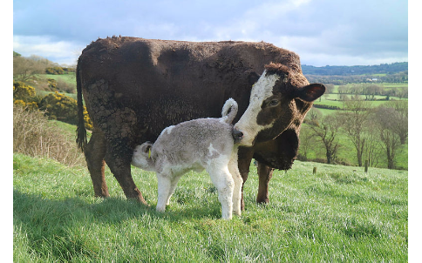
Beef price - What does the future hold?
Notes:
This is a question that is consistently on the mind of everyone in this room…

Slide 3
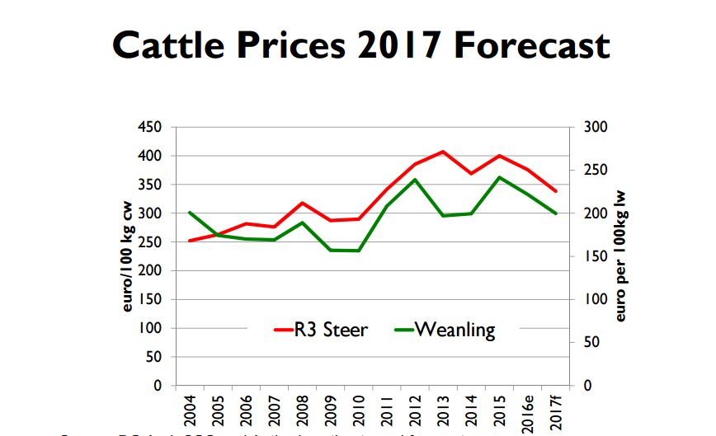
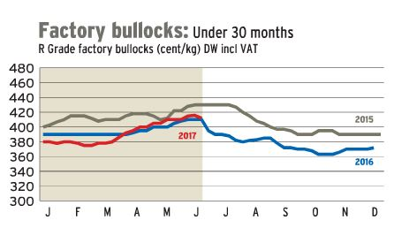
Rewind the clock
2017 Forecast – “Irish cattle prices forecast to decline strongly”

Slide 4
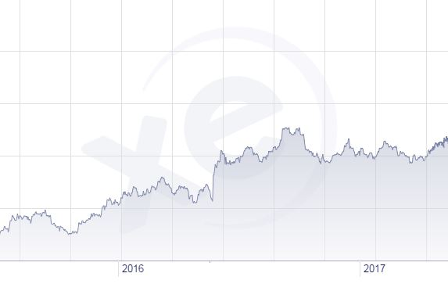
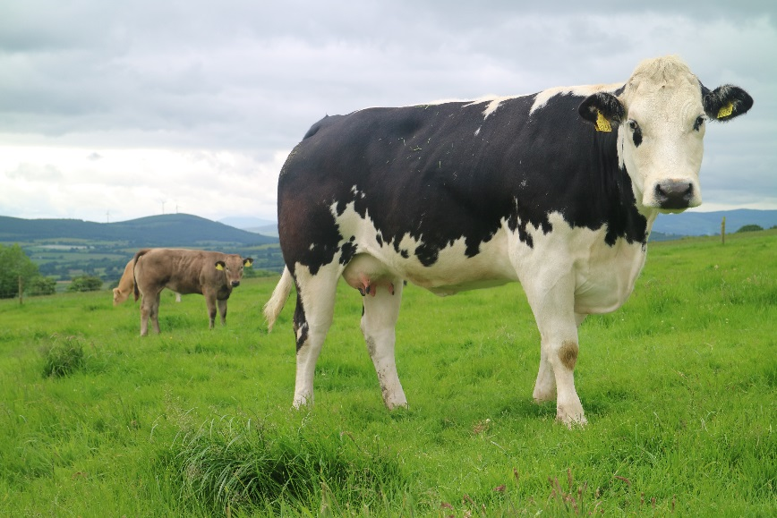
Rewind the clock
What’s driving beef price?
Exchange rate
Manufacturing beef in Asia
High pig prices
Australian kill down
USA price high
Brazil rep ruined
What’s the point??
Four walls…
No control!
Notes:
Sterling forecast to weaken against the euro in 2017….
Manufacturing beef in asia and elsewhere
Speculation/forecast is an exercise in futility.

Slide 5
Beef price - What does the future hold?
????????????

Slide 6
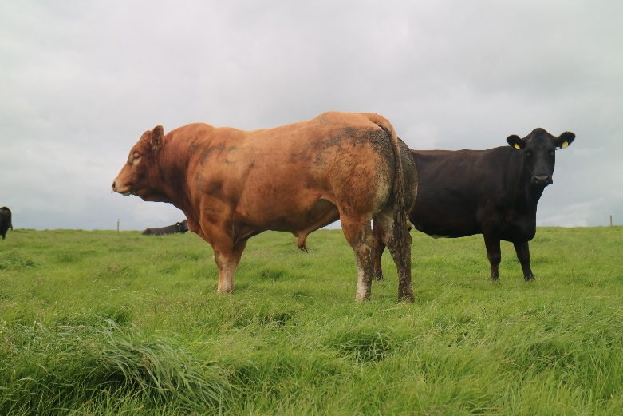
What is the €500/cow challenge?
Finding an extra €500 net profit per cow
40ha farm
Published in Irish Farmers Journal
National average levels of technical efficiency
Very few here - potential
Notes:
Published in paper…back then €150 Adam gave me nice surprise when he said he’d submitted paper on our behalf as 500 and I was presenting it – we’ll give it a go, no pressure

Slide 7
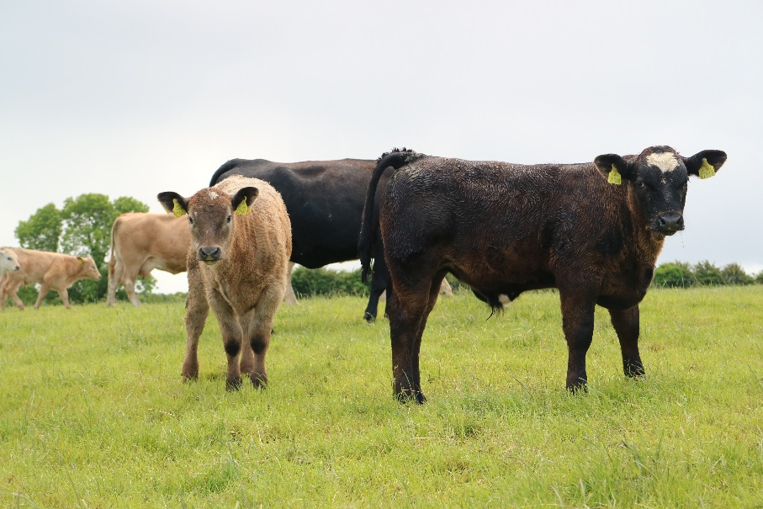
What is the €500/cow challenge?
Grassland
Age at first calving
Reproductive efficiency
Calf weight gain
Notes:
Where we can find more money by embracing best practice around
Grassland – Mike Egan touch on it in more detail
Calving cattle younger
Hitting reproductive efficicncy targets
Maximising calf weight gain
Offer hints and tips along the way
Very much an appetite whetter for more in depth presentations to follow!

Slide 8
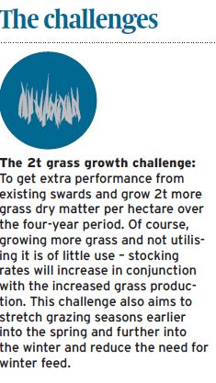
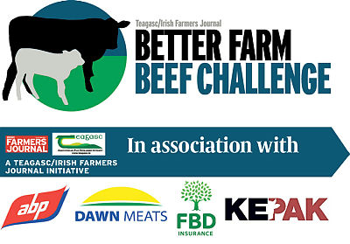
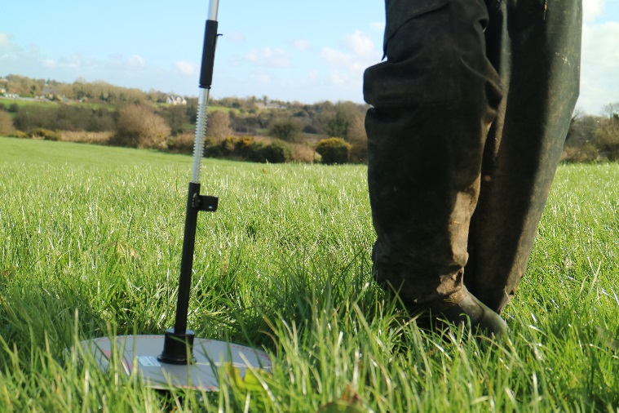
Grassland
Every extra 1 tonne of grass utilised = +€105 net profit
Average farm utilising 5-7 tonnes/ha
Top operators utilising >12t/ha
BETTER farm = 2t/ha
Two tonnes = €186/cow
Equivalent to 0.57c/kg beef price rise
Notes:
2 tonne realistic

Slide 9
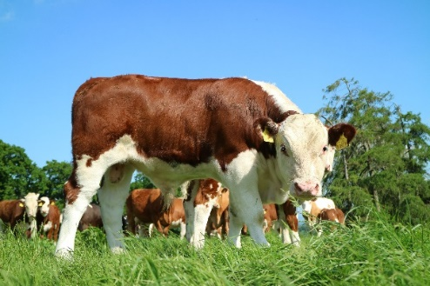
Grassland – how? Soil health
Teagasc 2015 - 13,541 samples – 91% deficient
Consider those soil sampling!!
pH (lime) – correcting = +10% grass production regardless
6:1 return on investment over five-year period
Phosphorus (P) index 3 versus index 1 = 1.5t grass/ha/year

Slide 10
Grassland – how? Infrastructure
More paddocks:
More grazings
More stock
More gain from grass
Consider relative cost of feed
Notes:
Don’t mean stud fencing, even permanent fencing – reels and pigtails. Split split and split again. So much power, so much control over your farm as a grass producing asset. Cattle will get used to it and your eyes will be opened to what you can achieve as a grassland farmer very quickly. Stanleys in Tipperary.

Slide 11
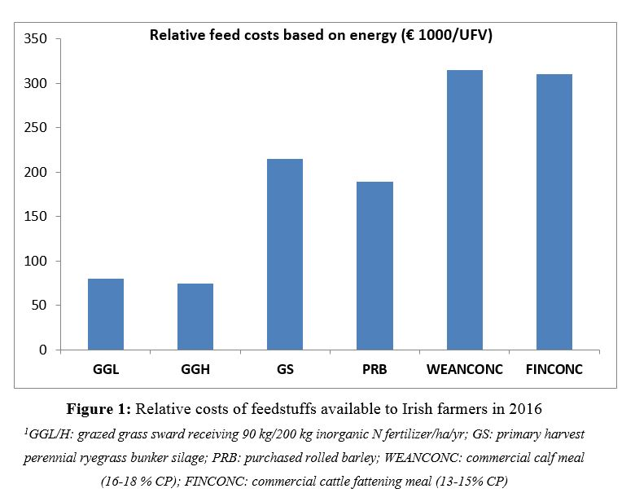
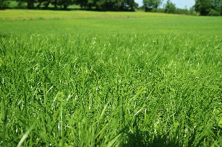
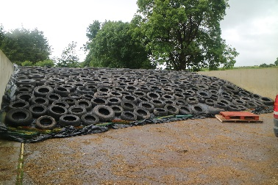
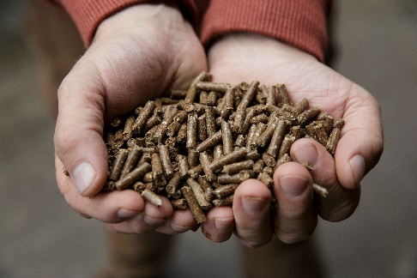
Relative feed costs on an energy basis (€/1000 UFV)
Silage
Concentrate feeds
Grazed grass

Slide 12
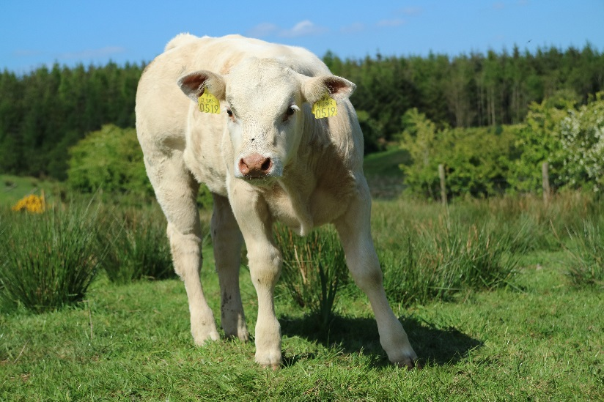
Grassland – how? Measuring
Think about graph:
“How many tonnes of barley?”
“How many tonnes of grass?”
Must measure to manage…
100 vs 650
x5 more drystock farmers!!!
Notes:
Come and talk to myself, adam, Mike or Bernard after and we can get you going on measuring the farm with no big investment in equipment

Slide 13
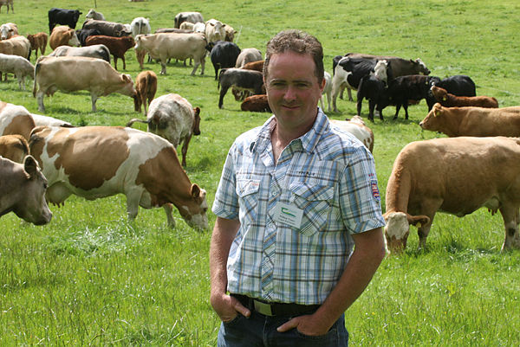
Grassland – William Treacy
“The secret has been grass – we are growing and utilising as much of it as we possibly can. I got P, K and lime right, put in more paddocks and drinkers and began measuring grass weekly. This was key.
“Of course I was sceptical of what the (BETTER farm) team was telling me I could achieve, but measuring gave me peace of mind that I could in fact feed these extra mouths they were calling for.”

Slide 14
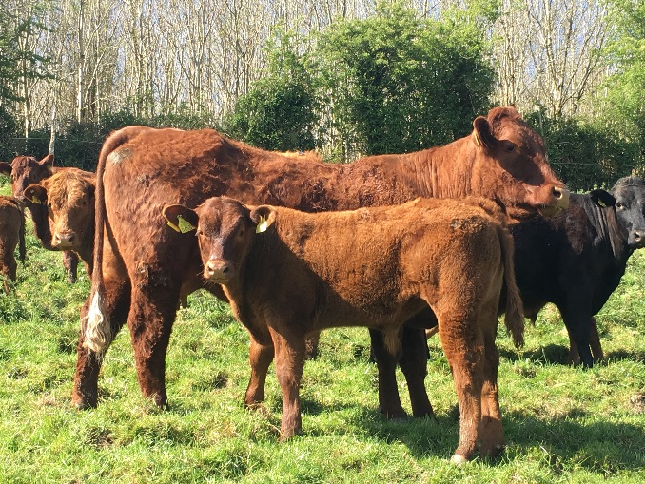
Heifer calving age
Average Irish heifer 31.5 months
Tells us:
Research
Calving spread
Assume defined calving spread – 24 versus 36 months
40ha farm, 170kg N/ha, 2yo steer and heifer beef
€84/cow
Notes:
Research and best practice ignored
2yo calving practices without hesitation across the globe – the norm in North America
Calving spread all over the place, animal should calve on birthday like clockwork

Slide 15
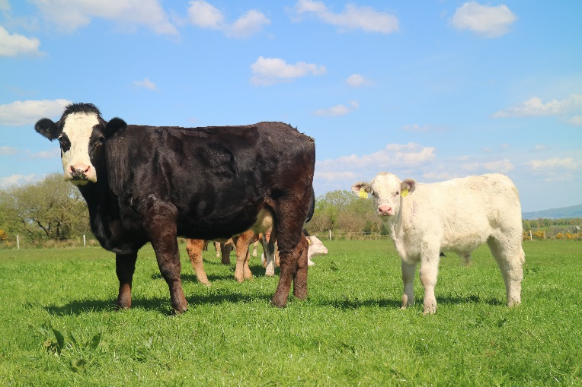
Two year-old calving – How?
Sire selection – <5% calving
high reliability – stock bull?
AI an option? Sync? Tightness?
Weight?
“stunt” – mature weight 5/6 old!!
Feeding and management – we have full control
Notes:
Vast majority not correct – stunt

Slide 16
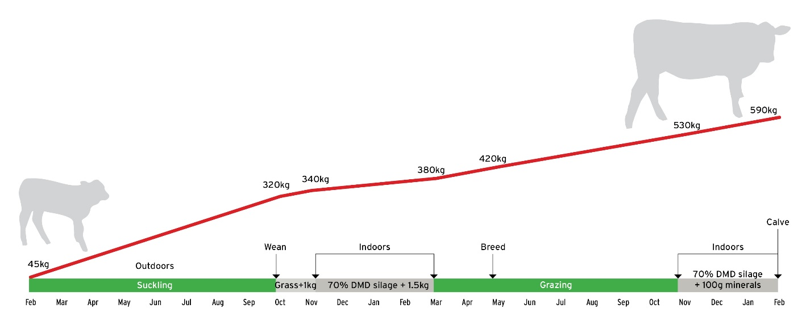
Two year-old calving – How?
530kg
320kg
Notes:
Focus on winters – assuming grass optimized

Slide 17
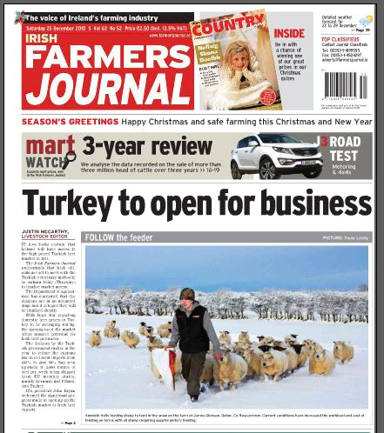
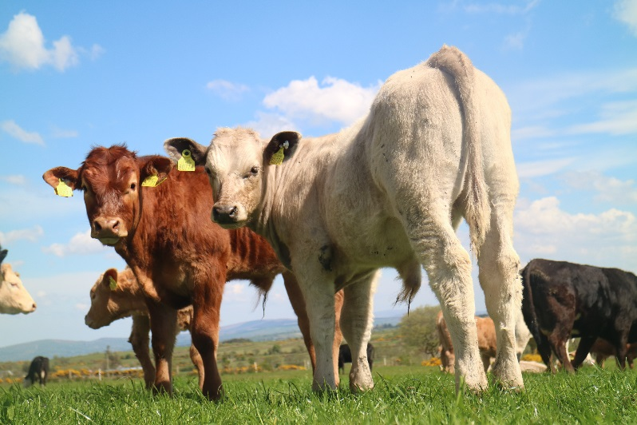
Two year-old calving
Pick bull June 2017
3yo calving – end 2021 weans?
“Established cow” – 3/4 lactation?
Bulls we picked 7 years ago…
Volcanic ash and Chilean miners
Notes:
Heifers calf fruits of my high replacement index bull selection don’t come into being until

Slide 18
Reproductive efficiency
 | Average | Targets
Calving interval | 399 days | 365 days
Mortality | 6.4% | <5%
Calves/cow/year | 0.82 | 0.95
Females not calved | 9% | 0%
Notes:
Cows losing a month every year 2/10 cows now calf 10% passengers

Slide 19
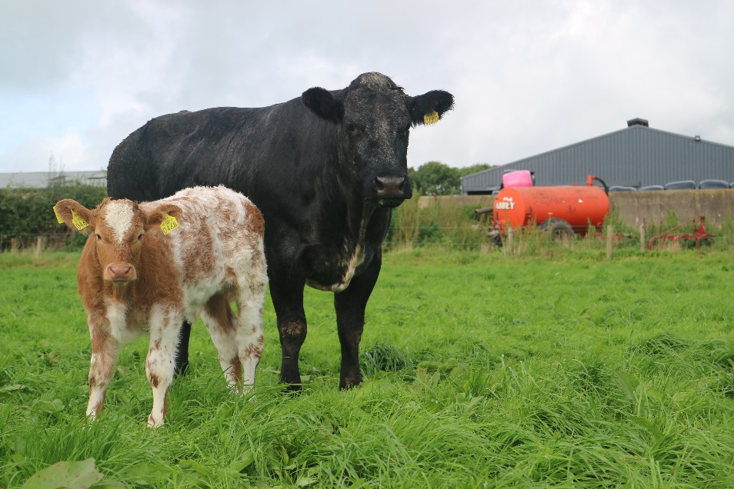
Reproductive efficiency
Back to our 40ha farm…
Calving interval
399 to 365 days = €75/c0w
Mortality
6.4% to 4% = €21/cow
Notes:
Forgone weaning weight, unnecessary extra feed costs. €2.20
Modest profit of €150 less, cow feed costs and less carcases to spread fixed costs over

Slide 20
Reproductive efficiency – how?
ICBF Herdplus calving report. What’s calving interval?
Cows that took a year out and weren’t culled, i.e. “females not calved in period”? Why?
Consider a pre-breeding scan, or mid-breeding season on any cows that haven’t shown heat 50-55 days post-calving.
Mortality high in 2017? up pre-calver mineral dosage and evaluate whether all cows are getting enough in restricted feeding situations.
Ensure every calf receives colostrum in the hours post-calving.
Where calves can’t get out, be liberal with straw
Notes:
20 minutes for suckler calf to get in enough colostrum – couple pulls not enough
18 cows 20-cow herd 365 2 year over average over 400 days

Slide 21
Weight gain
Table 2: Cow milking-ability affects bull growth on Meath farm
Cow | 271 | 344
Replacement index. | €43 (2-star) | €117 (5-star)
Cow sire | HKG | HKG
Calf sire | OZS (LM) | OZS (LM)
Daughter milk index (reliability) | 3.3kg (61%) | 7.5kg (59%)
Calf DOB | 23/3/16 | 18/3/16
Daily weight gain to 10 Jan’ 2017 | 1.33 | 1.42
Table 1: Cow milking-ability affects heifer growth on Meath farm
Cow | 137 | 300
Replacement index. | €85 (4-star) | €77 (4-star)
Cow sire | HKG (SIM) | IS4 (SIM)
Calf sire | LGL (CH) | LGL (CH)
Daughter milk index (reliability) | 4.9kg (41%) | 9.6kg (58%)
Calf DOB | 31/3/16 | 3/4/16
Daily weight gain to 10 Jan’ 2017 | 1.14kg | 1.33kg
North America – weaning ratio for culling
Milk = 66% of calf’s weight gain pre-weaning

Slide 22
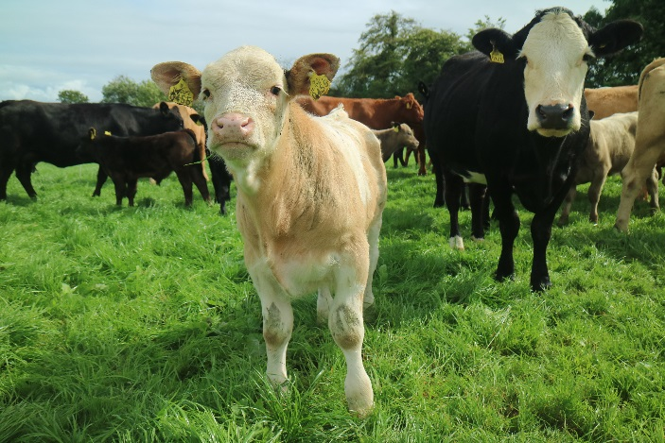
Reproductive efficiency
Average of 140g difference in daily calf growth rate on this farm
Sell live?
€2.60 x 34kg live weight @ 8 months
€89/cow
Lesson – rep. index enough?

Slide 23
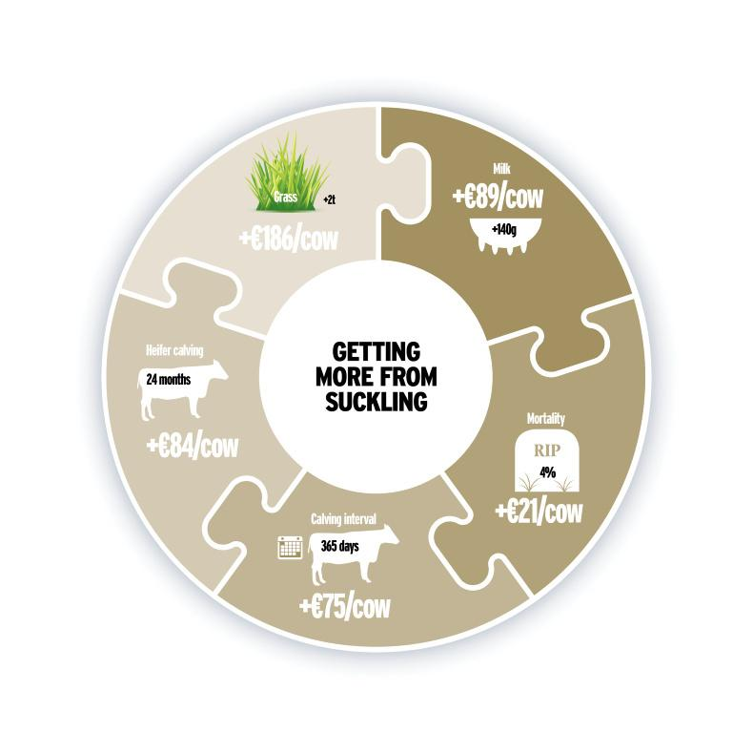
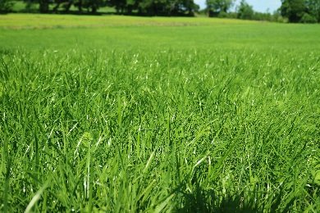
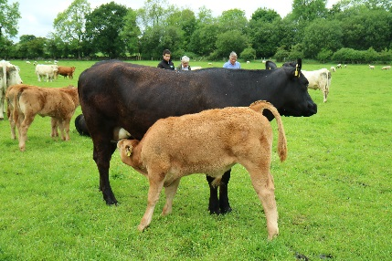
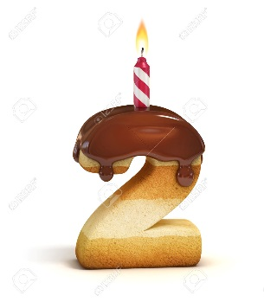
€186/cow
€89/cow
€455/cow
€84/cow
€21/cow
€75/cow
€21/cow

Slide 24
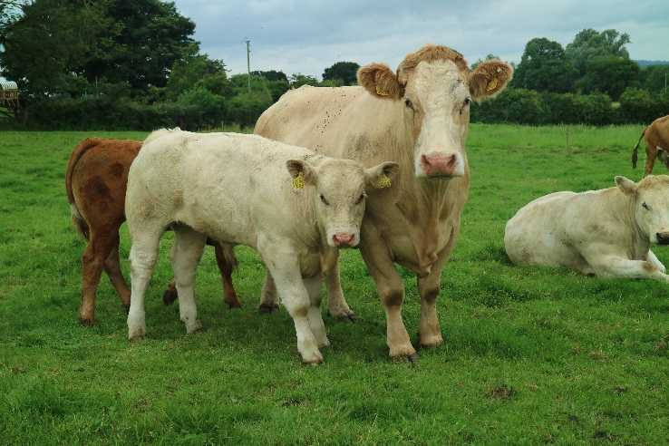
The verdict
Four areas = €455/cow
More scope:
Health?
Nutrition?
Forage quality?
2015 vs 2016 beef prices = €75/carcase
Again…
think POTENTIAL!
Find €250/cow → 40ha, 45 cows =
€4.87/kg steer base price

Slide 25
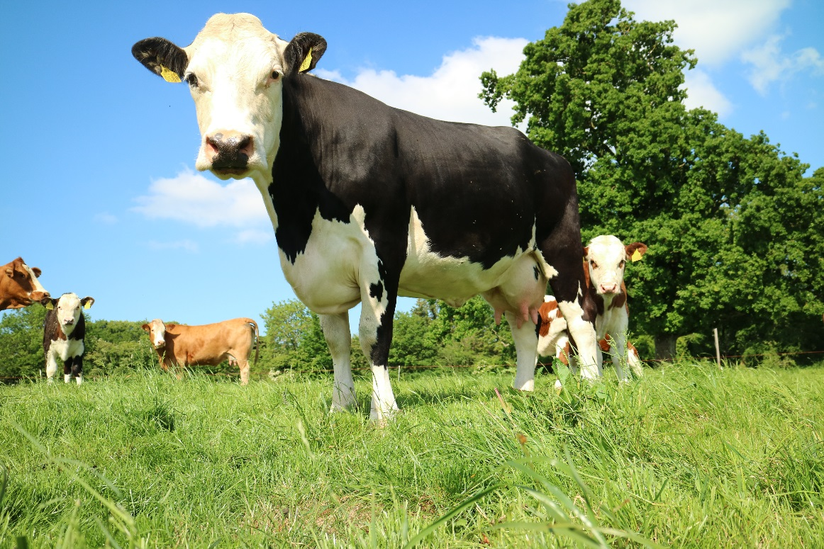
Thanks for listening

