Slide 1


Upgrading a Suckler Herd
Beef Conference 2016
Derek O’Donoghue
Salesian Agricultural College

Slide 2
Why Are We Upgrading?
€6,000 per year to be gained
Demonstrate Best Practice in Breeding

Slide 3
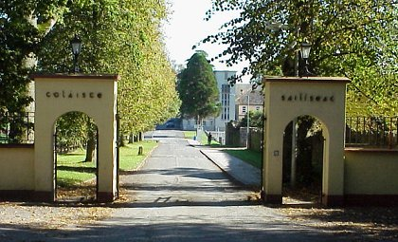
95 years in Agricultural Education

Slide 4


The Campus
Salesian Order
Salesian Agricultural College 650 students
Salesian Secondary School 620 students
Salesian College Farm 457 acres

Slide 5
Board of Governors
Edmond Harty – Dairymaster (Chair)
Doreen Corridan – Munster AI
Aisling Meehan - Solicitor & IFJ
Richard Kennedy – Dairy Farmer & IFA Deputy President
John Mullins – Dairy Farmer
John Furey – College Technician
John Donworth – Teagasc
Dan Carroll- SDB
Paddy Hennessey - SDB

Slide 6
The College Staff
Administration – 4
Agriculture Faculty – 12
Engineering Faculty – 7
Residential – 4
Farm- 4
Kitchen - 12

Slide 7
The Farm
185 Ha Owned (457 acres)
15 Ha Rented (37 acres)
Dairy
  250 cows
Beef
  50 cows
Sheep
  110 ewes

Slide 9

Courses Offered 2016/2017
Level 5 Certificate in Agriculture
Level 6 Specific Purpose in Farm Administration
Level 6 Advanced Certificate in Agricultural Mechanisation
Level 6 Advanced Certificate in Dairy Herd Management
Level 6 Higher Certificate in Engineering in Agricultural Mechanisation
Advanced Certificate in Agriculture (Distance Education)

Slide 10
Education is learning what you didn’t even know you didn’t know

Slide 11

Why?
‘To be a visual demonstrator of best practice’
ICBF says we can be more profitable
I believe ICBF
I trust in ICBF
ICBF can be your ‘best’ partner

Slide 13
4 & 5 Star Females Currently

Slide 14
Our Current Position

Slide 15
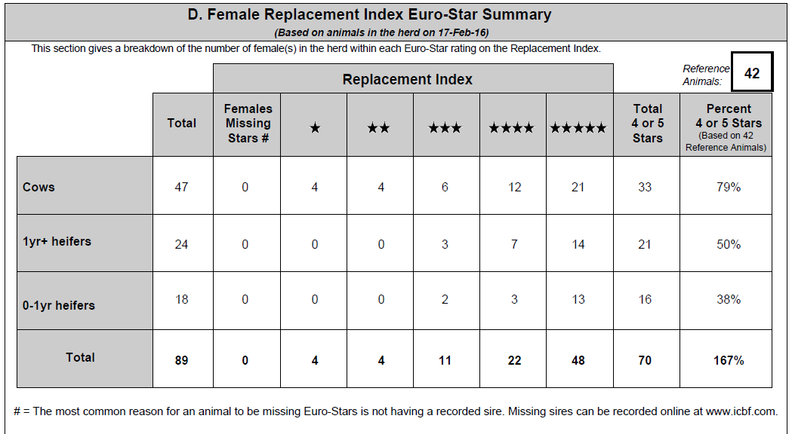
A Good Breeding Plan

Slide 16
Our Calving Reports
Year | No Calvings | Calving Interval | No Mths Calving
2015 | 42 | 385 | 7
2014 | 51 | 386 | 8
2013 | 42 | 380 | 6

Slide 17
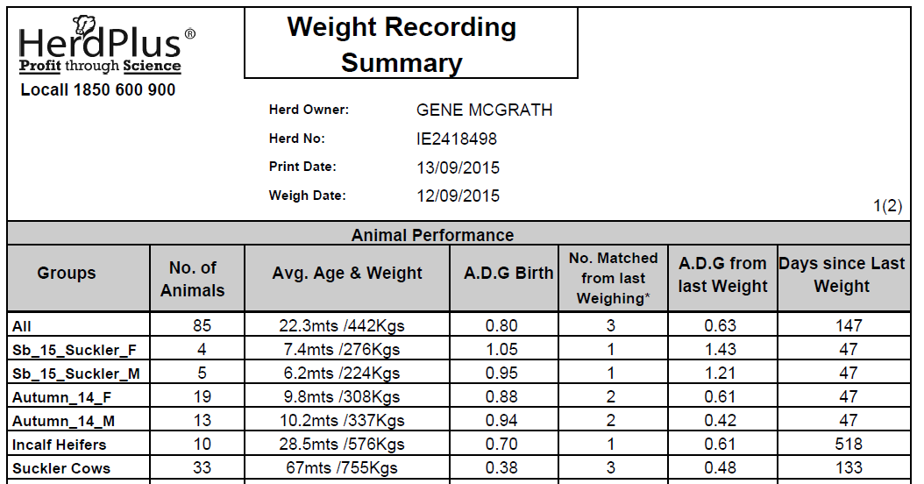

Slide 18
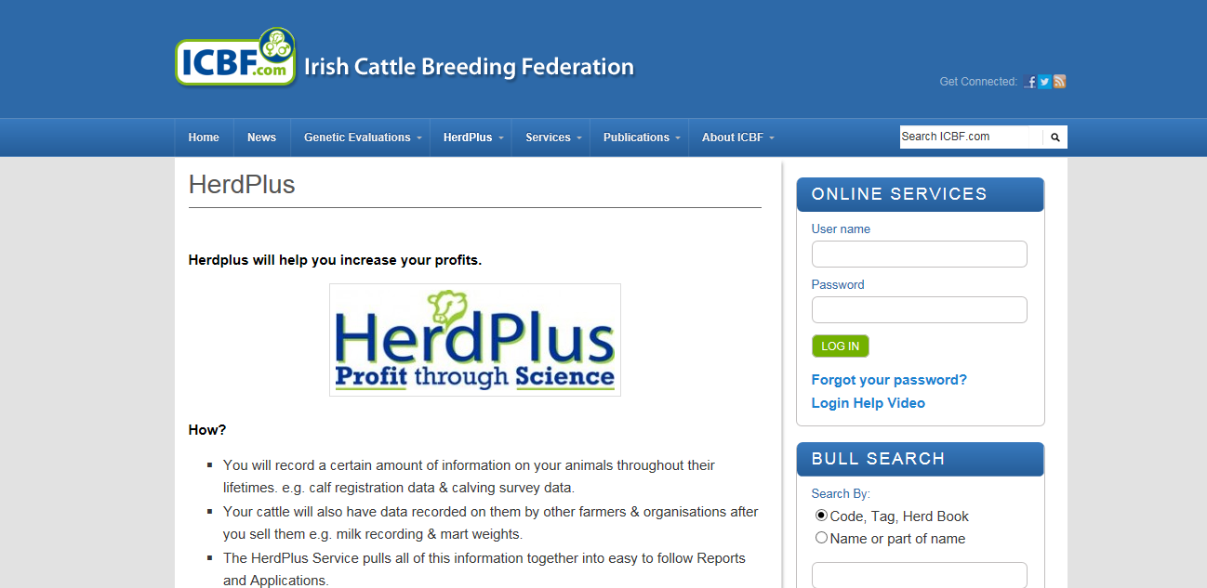
ICBF- Driving in the Dark With no Lights

Slide 19
Where We are Now on Maternal Index
Cow Average €65 (-€16 to €143)
Maiden Heifer Avg €46 (-€10 to €101)
Young Calf Avg €66 (-€30 to €111)
Target Top 5% €131
Target Top 1% €159

Slide 20
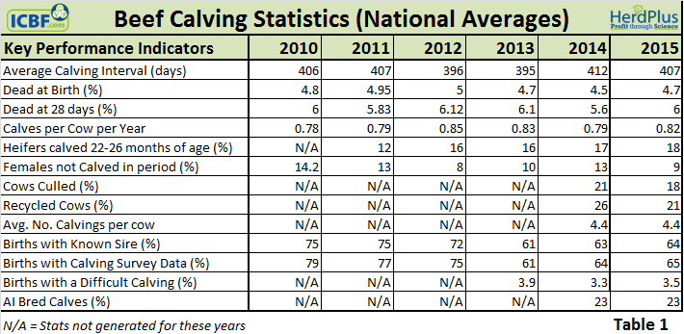
Target

Slide 21
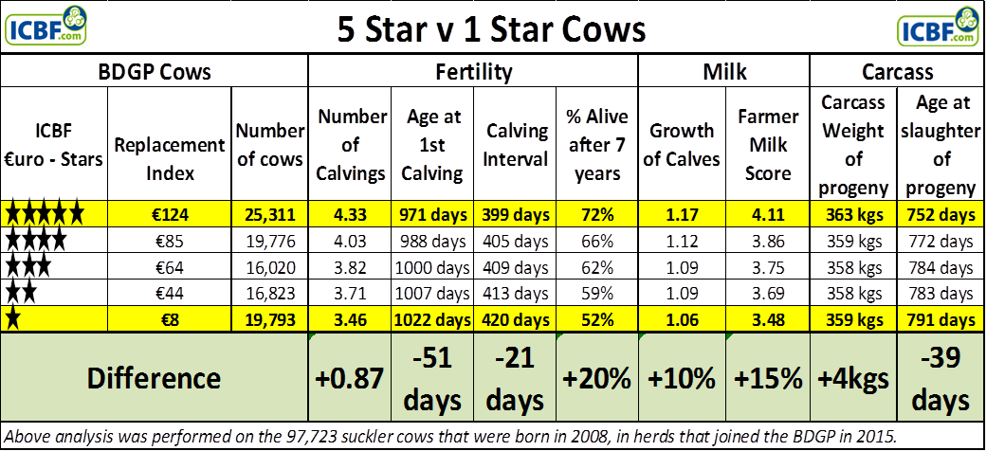
Will the stars help?

Slide 22
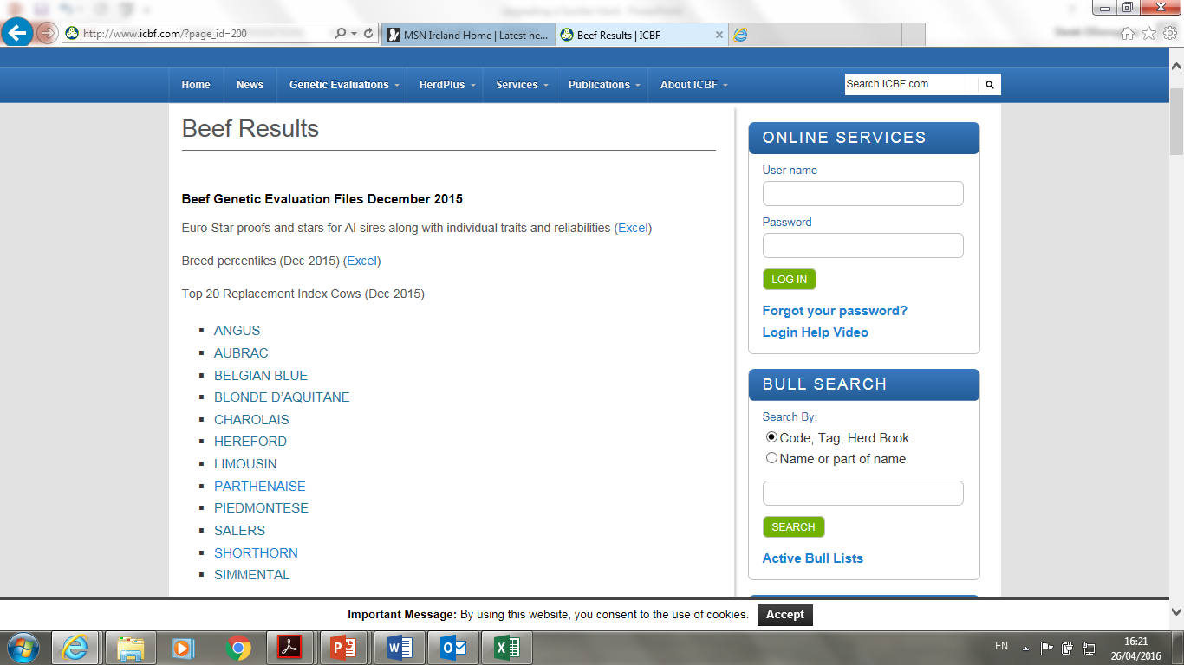
What is our Target?

Slide 24
The Best Non Pedigree Cows
 | Breed Percentiles (Animal basis), Dec 2015
The percentiles are based on pedigree animals born in each breed within 5 years from 1st January each year. They are moved up a year on the first run of every year i.e now they are based on animals born 2010 to 2015. The "All Breeds " percentiles form the basis of the Across breed stars and are based on All Breeds and commercials born 2010 to 2015. For Terminal across breed percentiles are based on pedigree animals only
Breed | Index/trait | type | records | sd | 1pc | 5pc | 10pc | 20pc | 30pc | 40pc | 50 pc | 60pc | 70pc | 80pc | 90pc | 95pc | 99pc
 |  |  |  |  | 1 star | 1 star | 1 star | 2 star | 2 star | 3 star | 3 star | 4 star | 4 star | 5 star | 5 star | 5 star | 5 star
All Breeds | Replacement Index (profit/lactation) | Profit Index | 2,440,899 | 39.4 | -€27 | €2 | €16 | €33 | €44 | €55 | €64 | €74 | €85 | €98 | €116 | €131 | €159

Slide 25
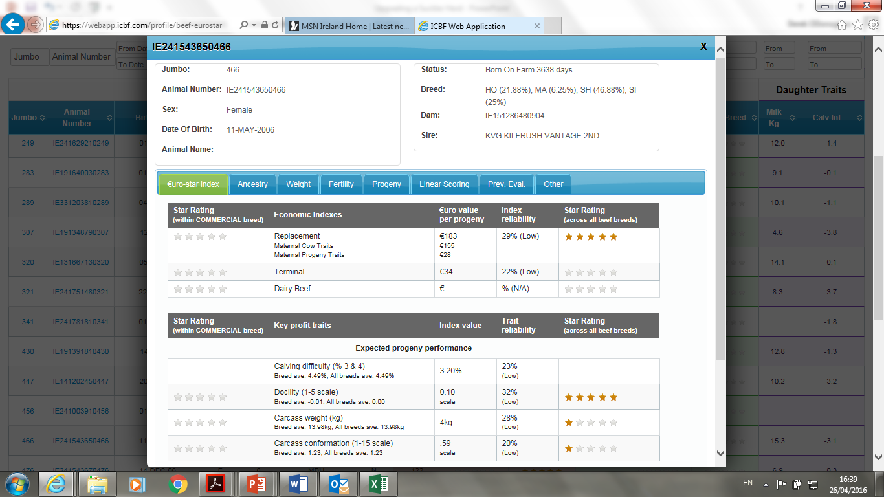

Slide 26
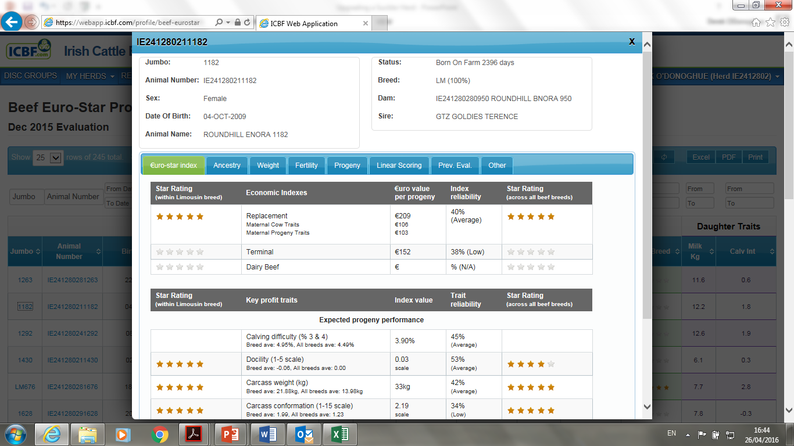

Slide 27
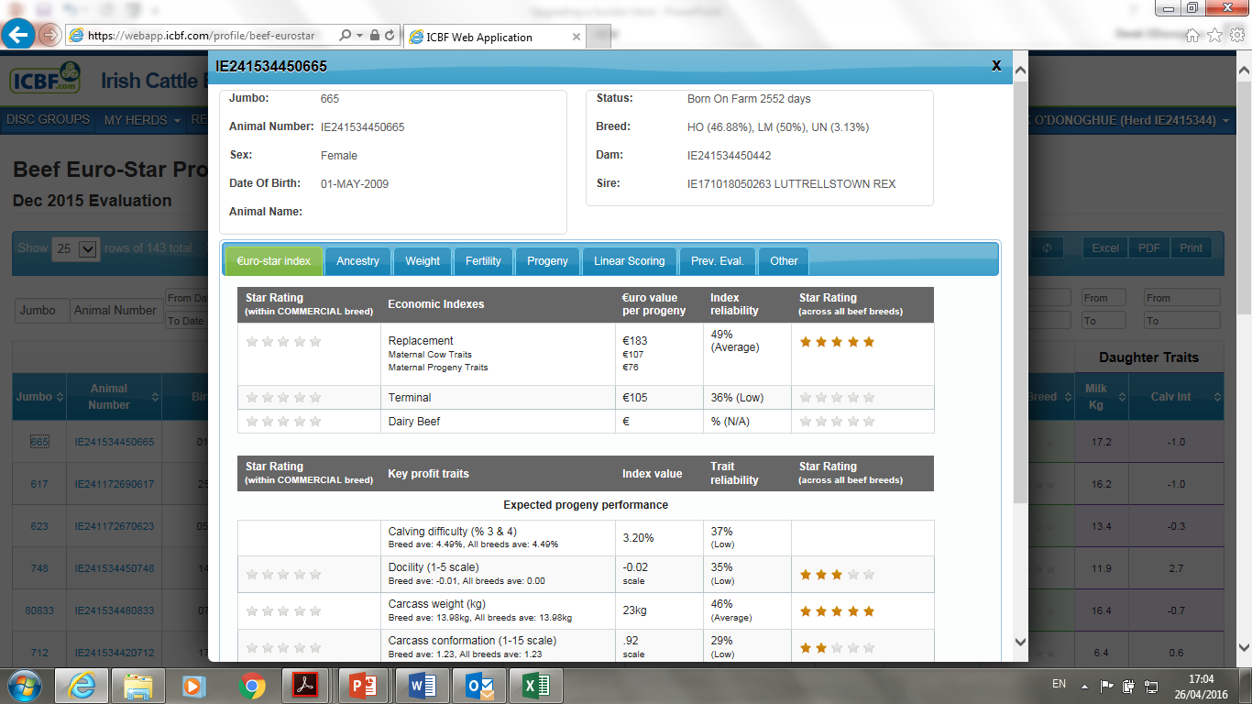

Slide 28
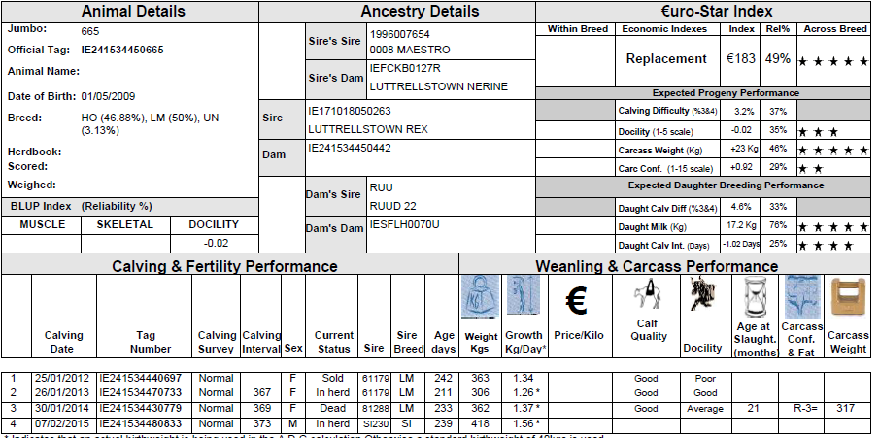

Slide 29
Selection Criteria
Maternal Index +€160 & balanced
Health Status Neospora + Johnes
Weight for Age Minimum 1.10Kg ADG Birth
Not interested in breed

Slide 30
The Most Dangerous Phrase
‘Because we have always done it that way’

Slide 31
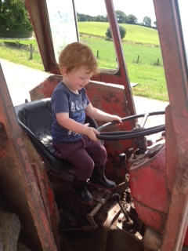

Slide 32

Breeding Genetic Merit Animals
Use of AI to breed replacements
Synchronisation + Fixed Time AI
Stock Bull after one round AI
Highest maternal bulls to be used (AI & stockbull)
Need ‘Sire Selection’ from ICBF as per dairy

Slide 33
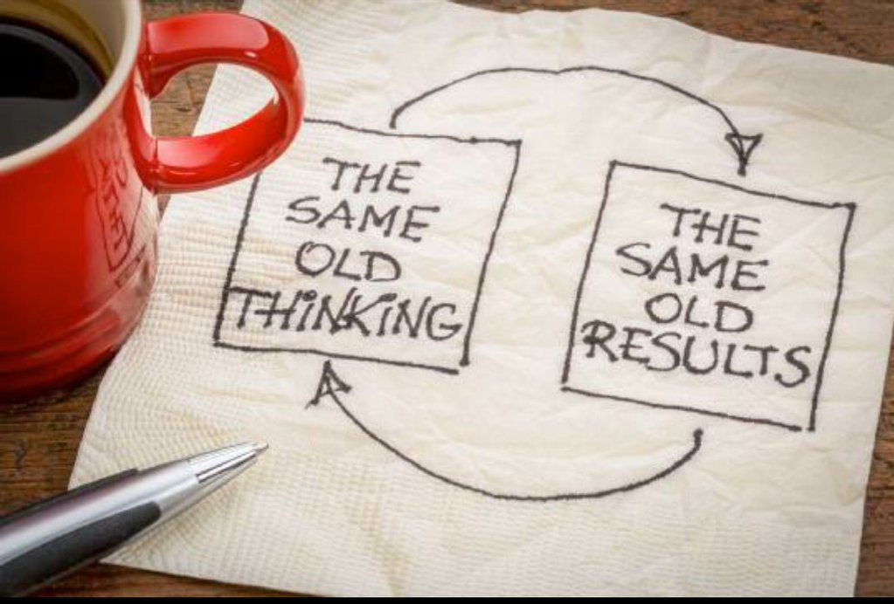

Slide 34
Why Are We Upgrading?
€6,000 per year to be gained
Demonstrate Best Practice in Breeding

Slide 35
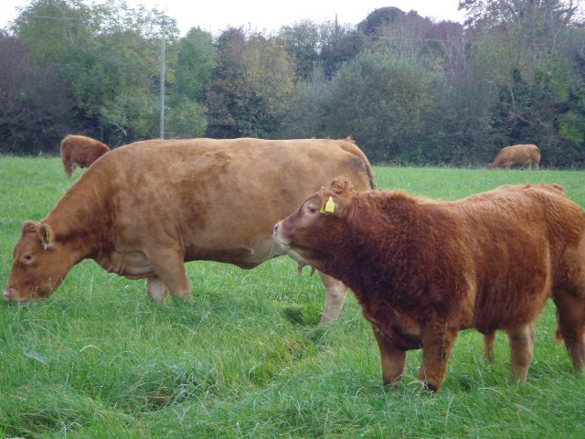
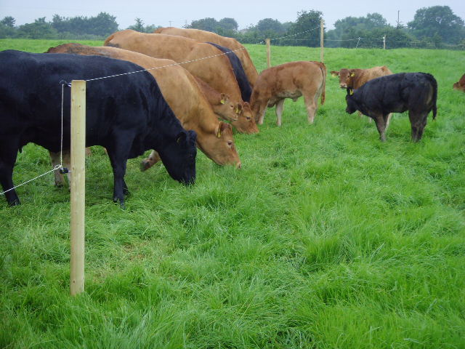
Conclusion
The student is number one, to learn you need to see & see the best
.
Notes:
35

