Slide 1
Financial Management a step to achieving your goals
Peter Young
Irish Grassland Association
Beef Conference
27 April 2016

Slide 2
What is good business
The business has an agreed purpose - GOALS
The individuals are skilled at good business
When the business benchmarks its performance
People understand their different roles and responsibility and are accountable to them
There is some degree of formality
When the business structure meets the long term family needs

Slide 3
Definition of a well run business/farm
Consistently profitable
Operate in sustainable way
Continues to grow/develop
Delivers high degree of enjoyment and satisfaction to owners and staff
Uses advisors/mentors

Slide 4
Most farmers – like to cycle own bike

Slide 5
Big difference in bikes

Slide 6
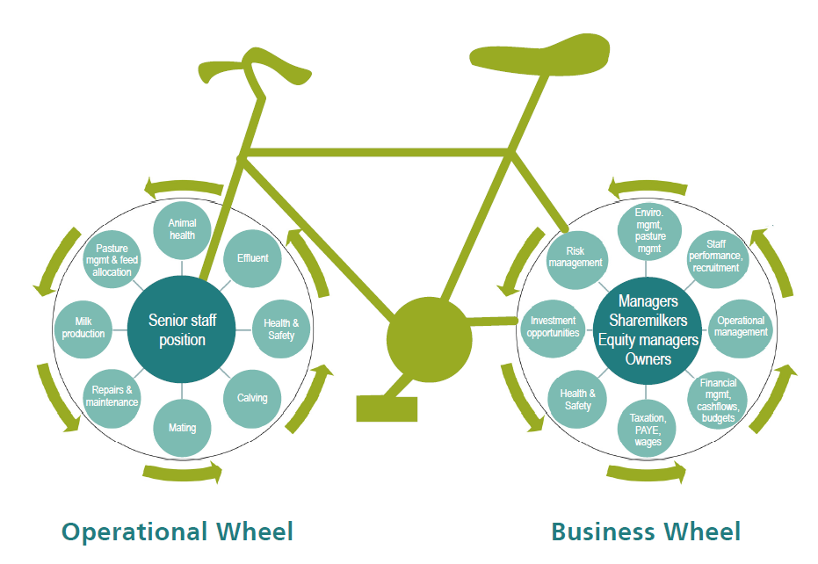
Riding the right bike

Slide 7
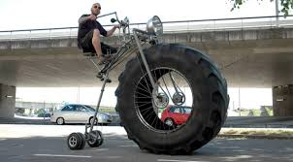
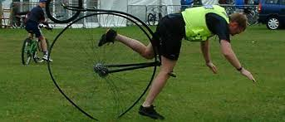

Slide 8
Financial Management
Start looking forward instead of backward
Planning
Setting goals
Cashflow budgeting
Keep it simple
Not gross margin
Money in v money out
Budgeted versus actual

Slide 9
Cash flow budgeting – a tool to achieve your GOALS

Slide 10
Cashflow challenge
Trying to get famers to focus on what they have
What they can control
Setting their GOALS
Having better control on finances
Better decisions
Fewer surprises
React quicker
Increases possibility of getting finance

Slide 11
What are your goals?
S - Specific
M – Measurable
A - Achievable
R – Relevant
T - Timely

Slide 12
Cashflow challenge
Eoin - A mixed sheep and beef farmer.
25 suckler cows
150 ewes
100 acres.
Goals
Remain a full time farmer
Ensure that the farm makes €20,000 to contribute to the household.

Slide 13
Have two bank accounts

Slide 14
Cashflow budgeting
Learn the basics
Cashflow - Not profit
No two are the same
Money in and money out of account each month
How much money at start of month
What flows in/out
How much money will be there at end

Slide 16
Cashflow budgeting
Avoid the excuses
Volatility
Beef price
Input price
Weather
Interest rates
Will never get it right
But you will get better at it

Slide 18
Cashflow budgeting
Understand your business
Have to do it yourself
Free
Select your tool
Pen and paper
Exel sheet
Teagasc cashflow planner
Cashminder.ie

Slide 20
Cash flow so far this year

Slide 21
Cashflow budgeting
Realise how you can manage cashflow
Cash buffer
Sale of stock
Bank facilities
Merchant credit – expensive
Cut spending
Avoid surprises
See problems before they arise
Banks love them

Slide 22
Cashflow budgeting
Set goals
Learn the basic
Select your tool
Avoid the excuses
Realise how you can manage cashflow
Avoid surprises - Banks love them
No two are the same
Start looking forward instead of backwards

Slide 23
Good business
1. Focus on what you can control
2. Set out a budget/cashflow– In v out
3. Be realistic about farm potential
4. Know where money is going
5. Know what it costs you to live
6. Start setting goals for your business
7. Set deadlines or it will not be done
8. Be determined – personal journey

Slide 24
Definition of a well run business/farm
Consistently profitable
Operate in sustainable way
Continues to grow/develop
Delivers high degree of enjoyment and satisfaction to owners and staff
Uses advisors/mentors

Slide 25
Who is on your board
Advisor
Accountant
Banker
Mentor
Partner
Trusted Friend

Slide 26
Understand the Perspective…

